Slide 1


Carousel
Carousel is a slideshow for cycling through a series of contents.It is a flexible and responsive way of adding slides.

Slide 2
Basic Steps of Creating Carousel
Add the .carousel and .slide classes to the container along with an id.
Specify the slides in a <div> with class .carousel-inner and each slide defined with .carousel-item class.
Add the .active class to one of the slides to make the carousel visible; otherwise the carousel will not be visible.

Slide 3
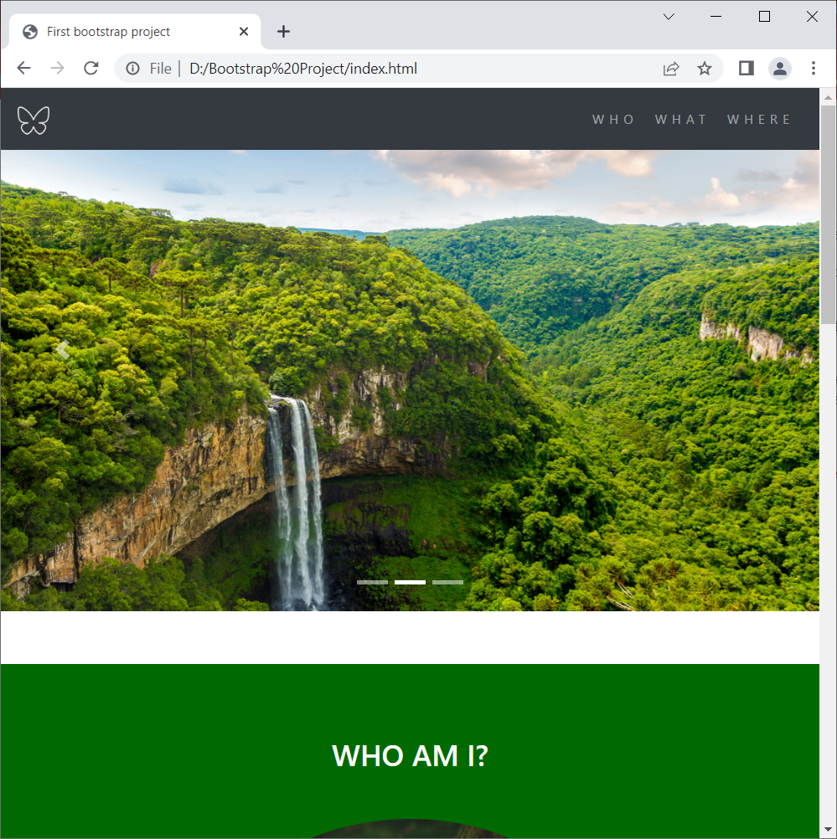
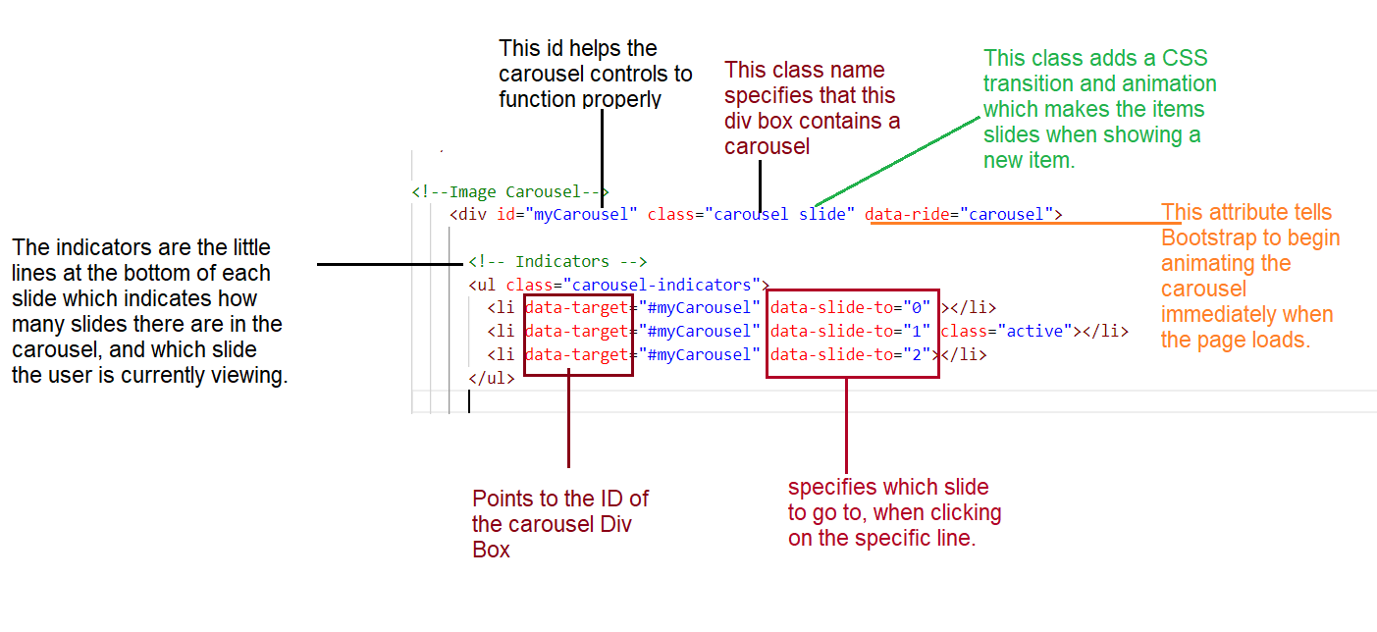
Adding .carousel and .slide
Classes for a Div Box.
.

Slide 4
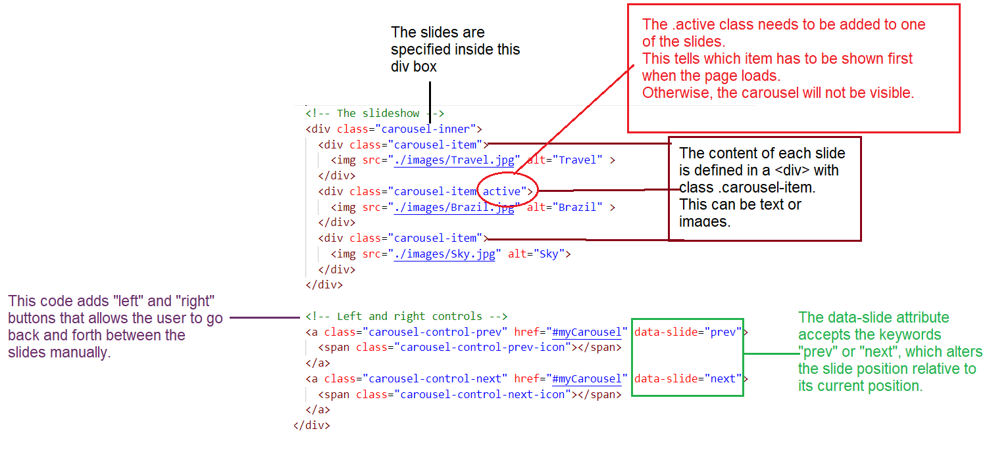
2. Adding Class .carousel-inner and each slide defined with .carousel-item class

